Slide 1
Webinar Innovatively replacing your lost or damaged certificate issued by Umalusi March 2023

Slide 2
Outline
Introduction
Background
Difference: First issue; Re-issue and Replacement
Why an alternative
System development and implementation
Overview of the process
Demonstration of the online system
Questions/Comments

Slide 3
Introduction
The National Certificates that Umalusi issues to candidates after they have qualified enable them to gain access to either further education, higher education or the world of work.
The question: What to do when the first issue of the certificate is lost or damaged?
This presentation explains what you need to do in order to obtain a replacement certificate from Umalusi.

Slide 4
Background
In terms of clause 17A (6) of the GENFETQA Act 58 of 2001, as amended, Umalusi is mandated to issue certificates:
“ The Council must issue certificates to learners who have achieved qualifications or part-qualifications.”
The Policy for the Certification of Candidate records on the GFETQSF provides for the certification procedure – all applications for certification must be directed to Umalusi via an Assessment Body.
All applications for certification go via an assessment body and there are processes and procedures in place, also on the e-platform.
This online application system provides an alternative for candidates to apply for a replacement of lost certificate directly from Umalusi.
The current processes will continue for those candidates who opt to apply via an Assessment Body to Umalusi.

Slide 5
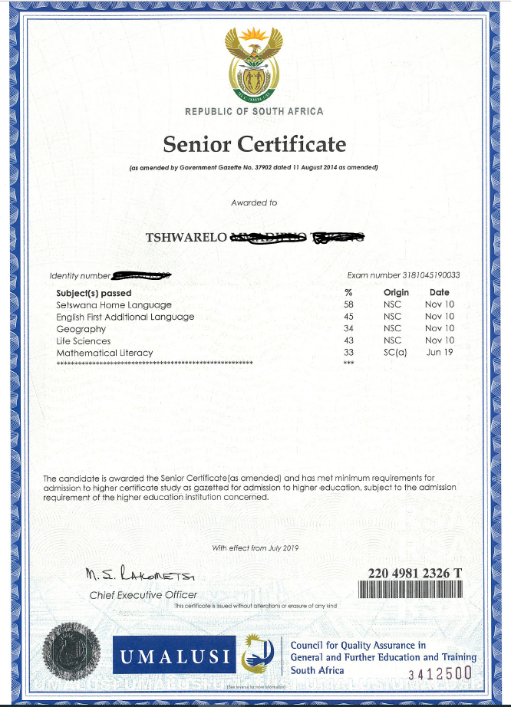
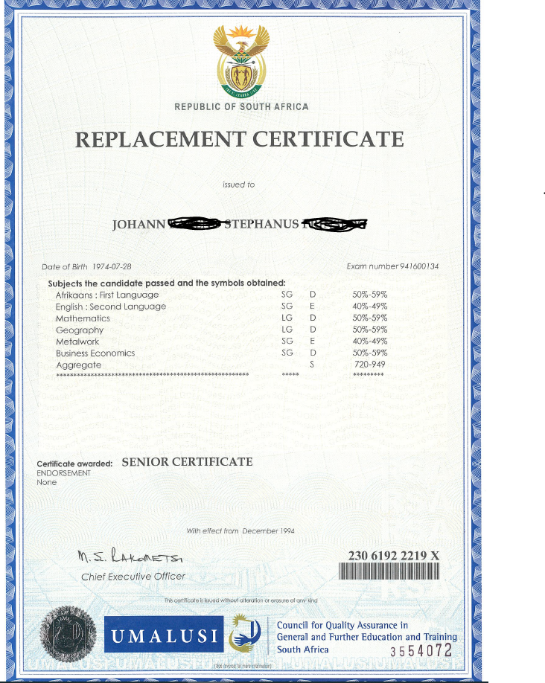
Differences: First issue, Replacement certificate and the Re-issue of a certificate.
First issue/Reissue certificate Replacement certificate

Slide 6
Procedure for application
Must provide a certified copy of ID/Passport.
Must provide a signed affidavit.
First issue certificate number will be cancelled and a replacement certificate with new certificate number will be issued.
A new certificate number must be used for the purpose of verification by a Higher Education Institution and/or Employer.

Slide 7
Why an alternative for the replacement of a lost certificate
Less costly, more efficient and convenient compared to traditional method:
Reduced turn-a-round time to issue a replacement certificate because applications are directed directly to Umalusi.
Candidates can apply from anywhere (home/office).
Time saving: no need to travel long distances to district, provincial of national offices.
Certificates can be couriered to a place of choice.
Cost saving: Save on traveling costs.
Reduce the paper trail: No more application forms.
Improved service delivery, reduced turn-a-round time.
The digital footprint is everywhere and requires that candidates should be able to apply digitally/electronically for the issuing of a replacement certificate.

Slide 8
System development and implementation
The online application system was deployed on 1 July 2022
It was implemented on a small scale to iron out all minor problems
Started with 11 printed certificates in the first month.
January – 333 replacements
February – 278 replacements
Grown substantially to 1 459 printed certificates as on 27 March 2023
Total number of profiles = 6 086

Slide 9
Overview of process
Candidate register and provide personal detail
Candidate apply for a replacement – upload ID and Affidavit
Payment of R129.00 for the replacement
Courier cost of R 65.00 if required – Only in SA
Turn-a-round time
Collection – within 2 days
Courier – 7 working days
Candidate can trace application process
Apply anywhere using your cellphone or personal computer

Slide 10
How does a candidate apply online for a replacement certificate?

Slide 11
Umalusi website

Slide 12
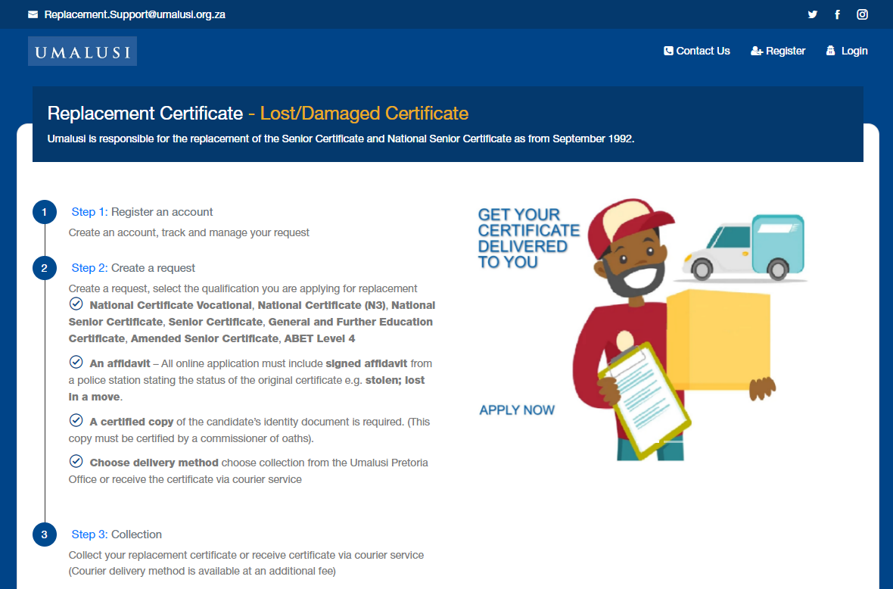
Landing page - applicant

Slide 13
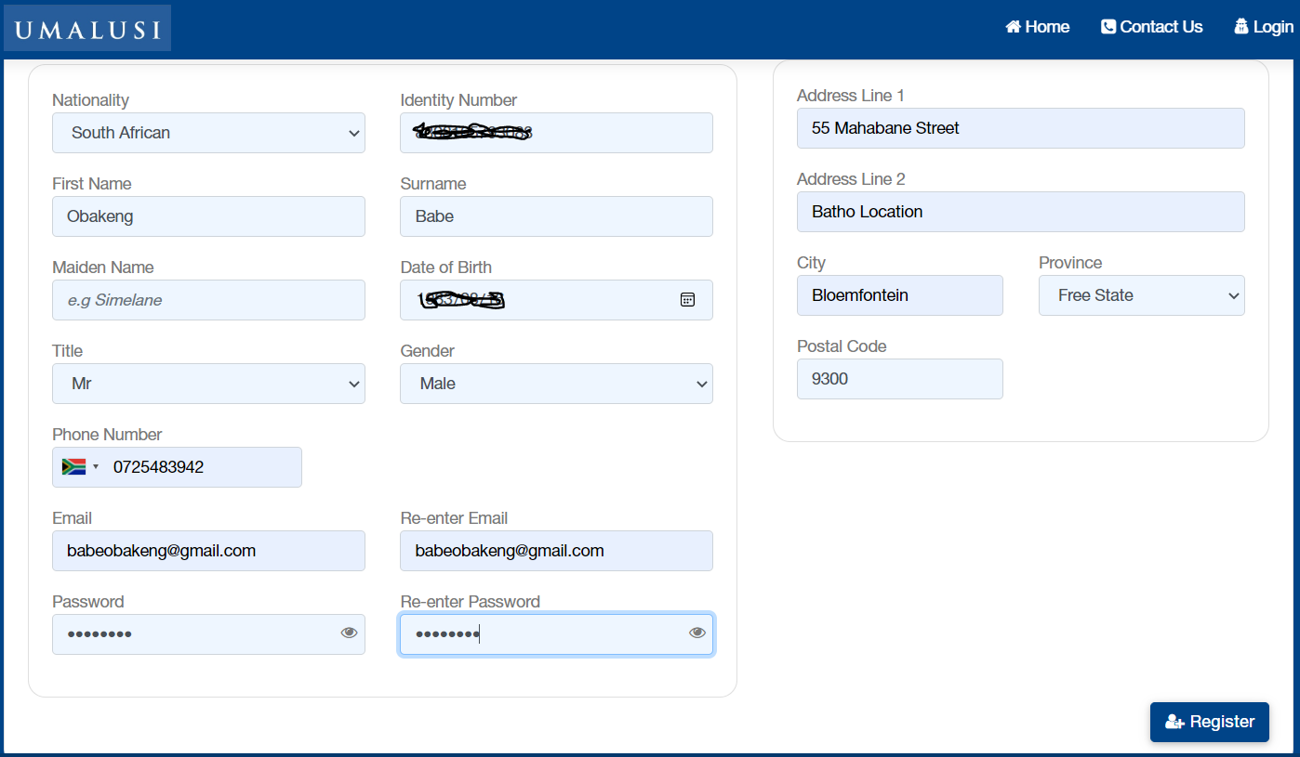
Step 1: Register an account

Slide 14
Step 1: Register an account

Slide 15
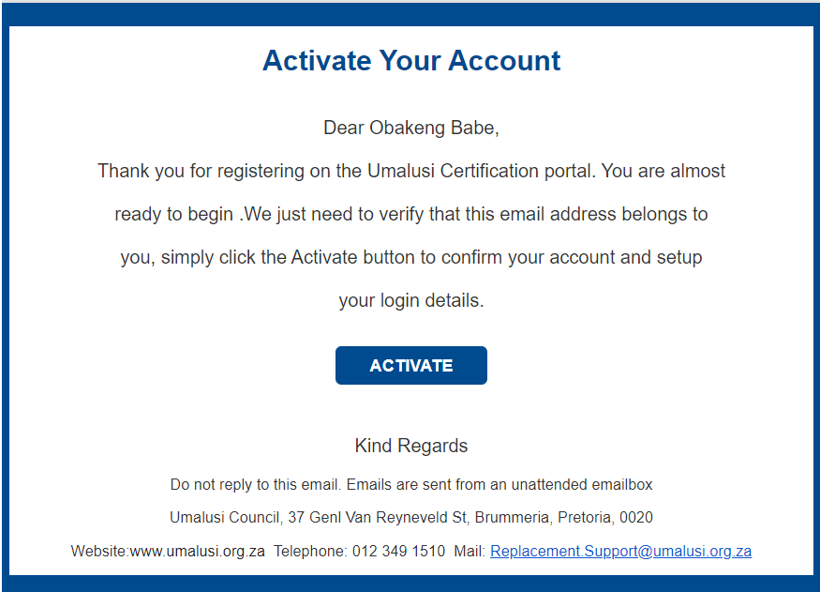
Step 1: Register an account

Slide 16
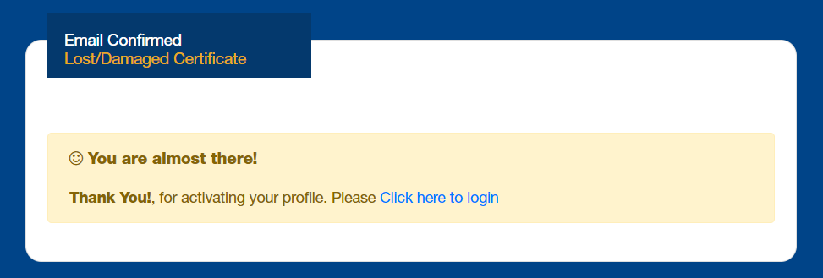
Step 1: Register an account

Slide 17
Step 1: Register an account

Slide 18
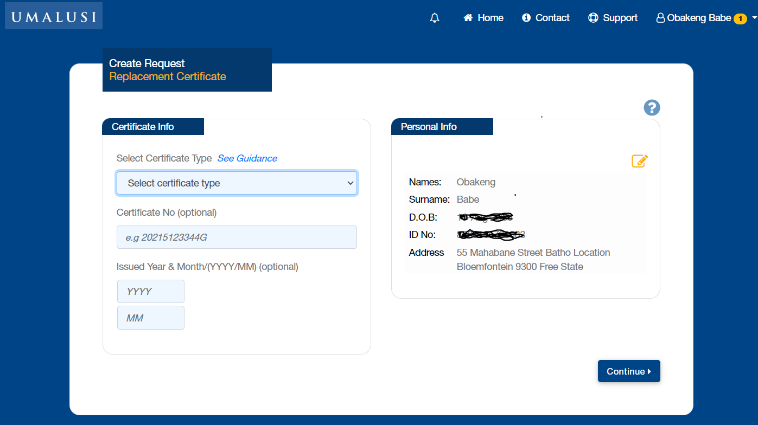
Step 2: Create request (detail)

Slide 19
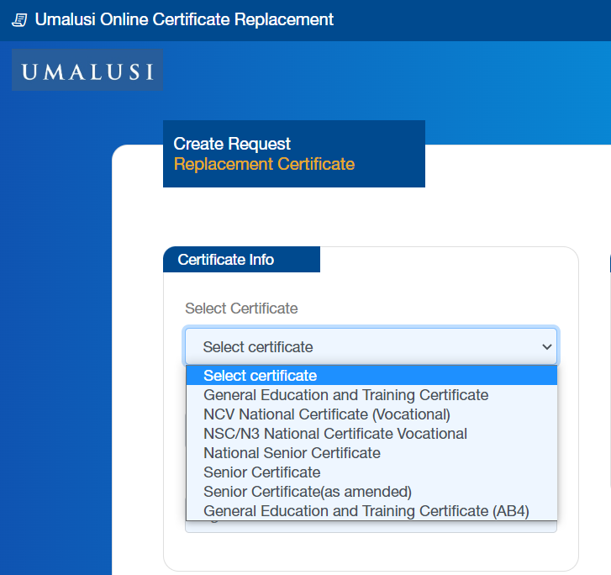
Step 2: Select type of certificate

Slide 20
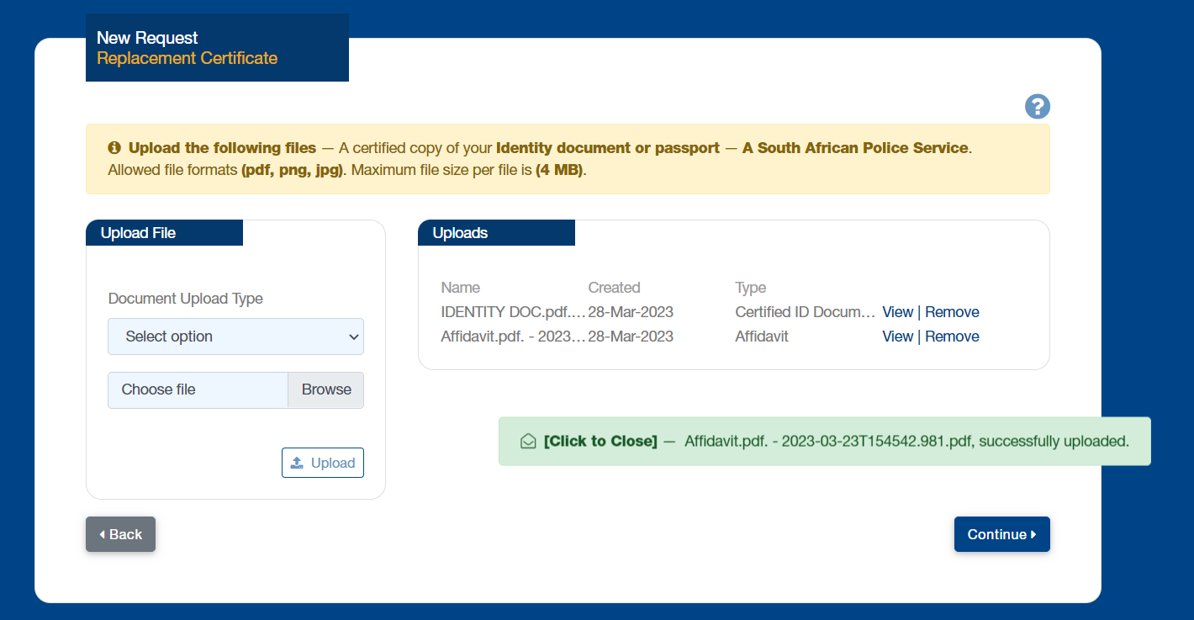
Step 2: Upload documentation

Slide 21
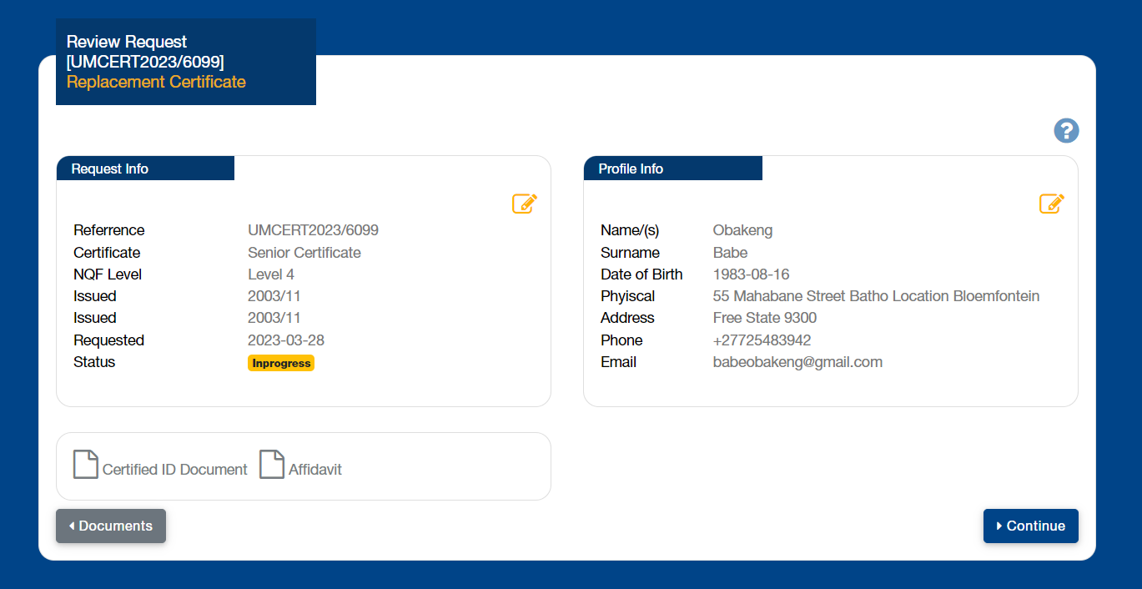
Online application process

Slide 22
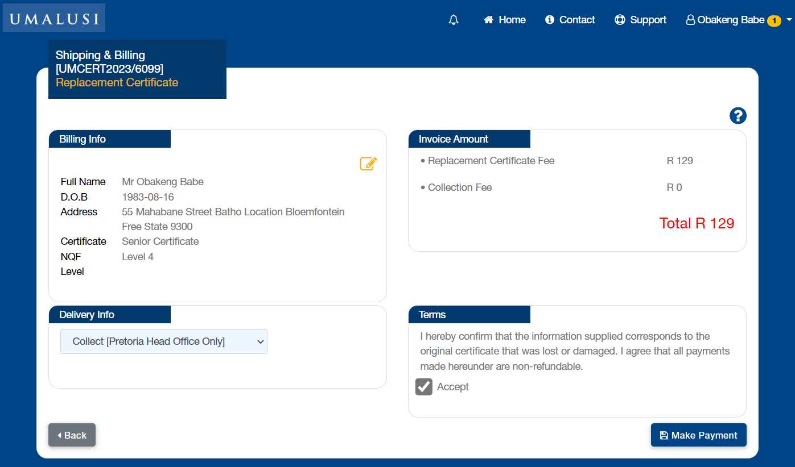
Step 2: Choose collection/courier

Slide 23
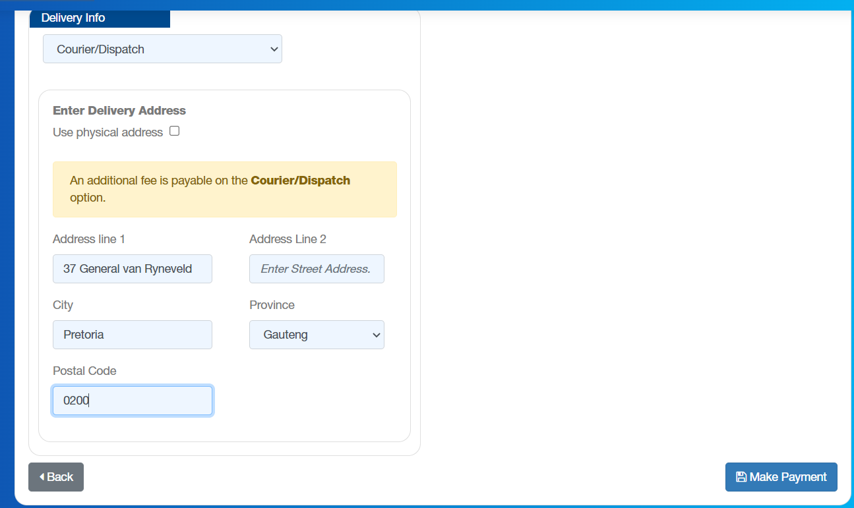
Step 2 – Provide delivery address

Slide 24
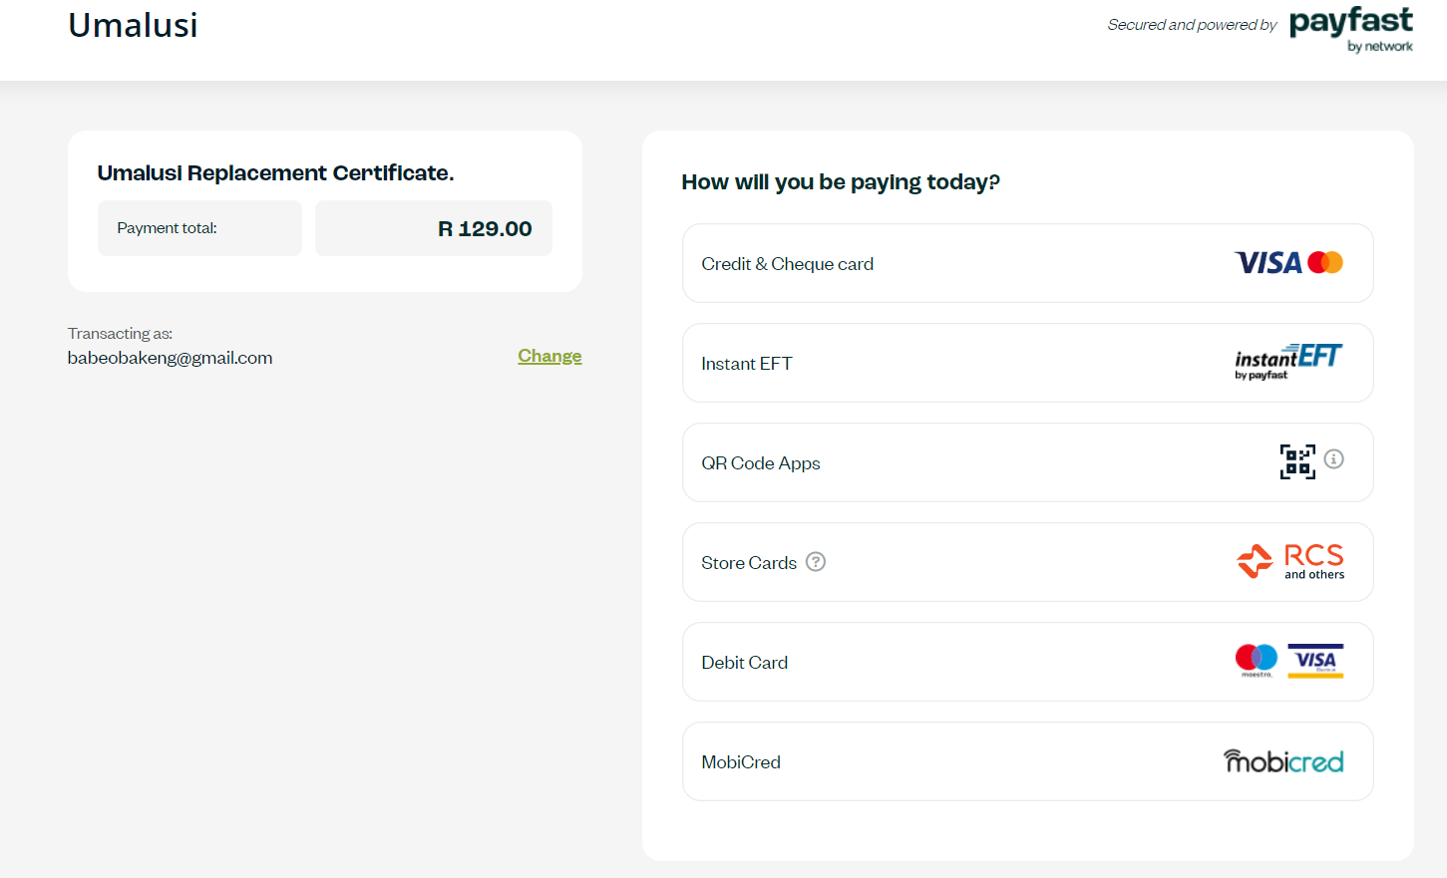
Step 2: Payment

Slide 25
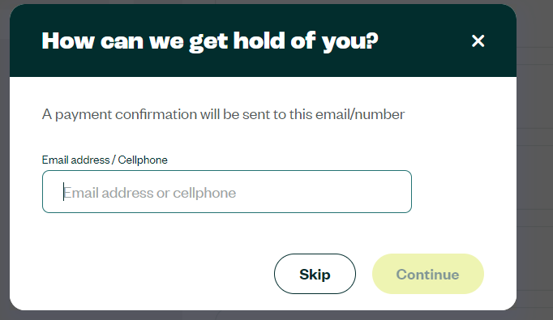
Step 2: Payment

Slide 26
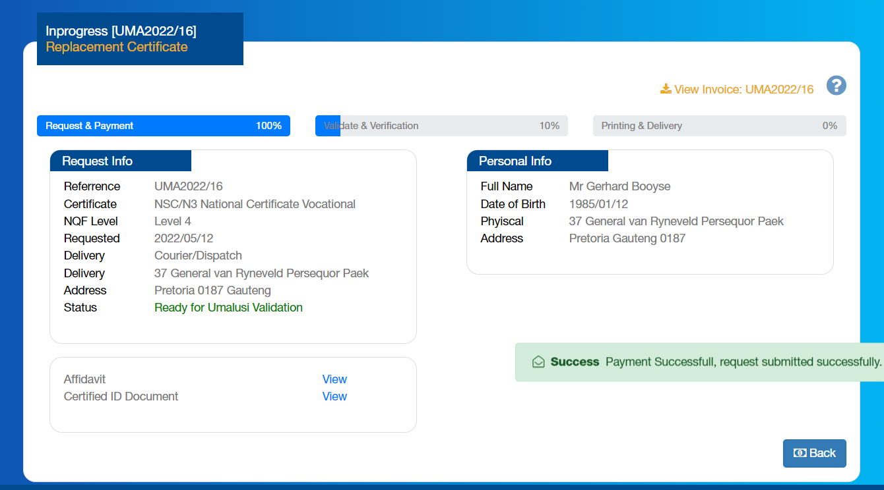
Step 3: Track your application

Slide 27
Flyer with the processes

Slide 28
Questions?
Comments!

Slide 29
THANK YOU

